Slide 1
VISUALIZING ELAN DATA WITH TABLEAU
BY DEANNIA LUCAS

Slide 2

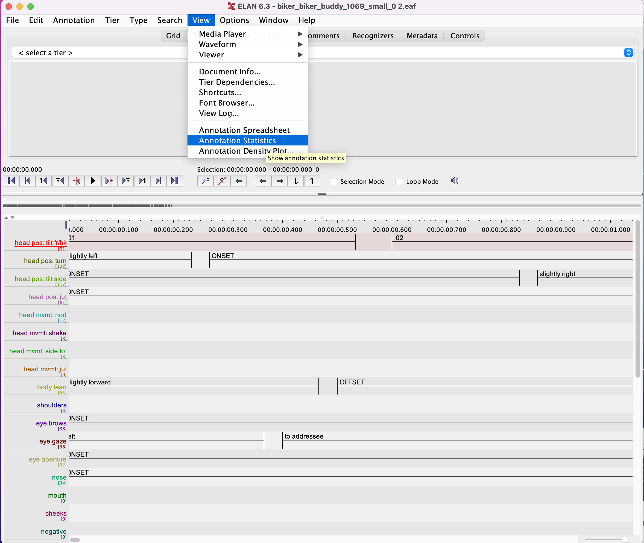
EXTRACTING DATA FROM ELAN step 1 Choose annotation statistics from view menu

Slide 3
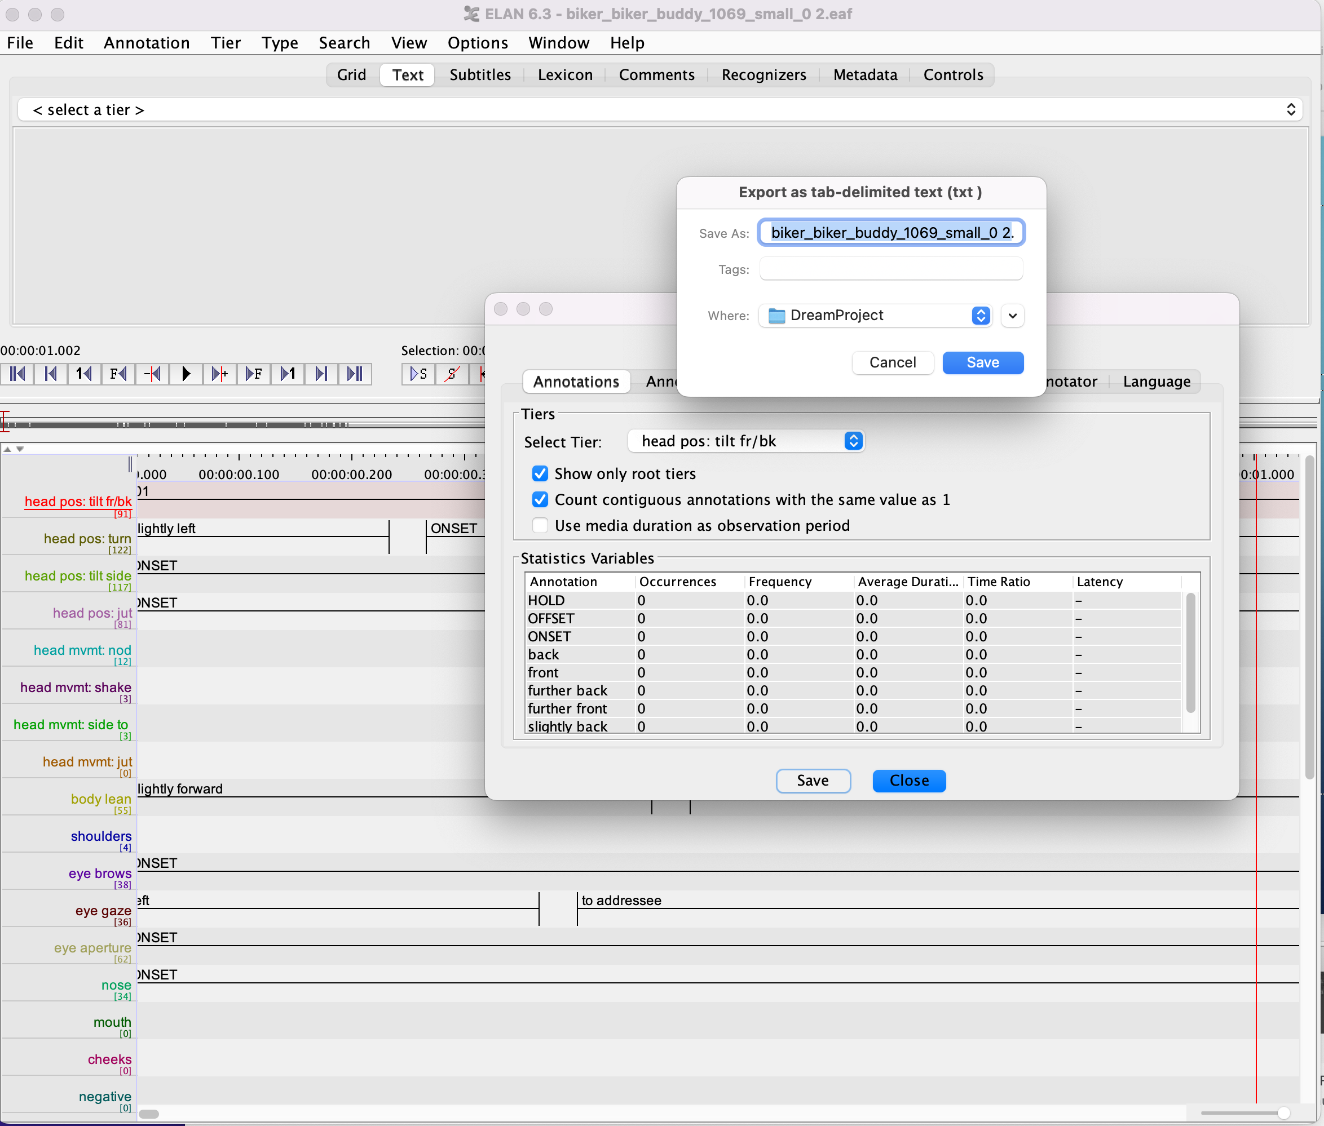
Step 2 save delimited text files

Slide 4
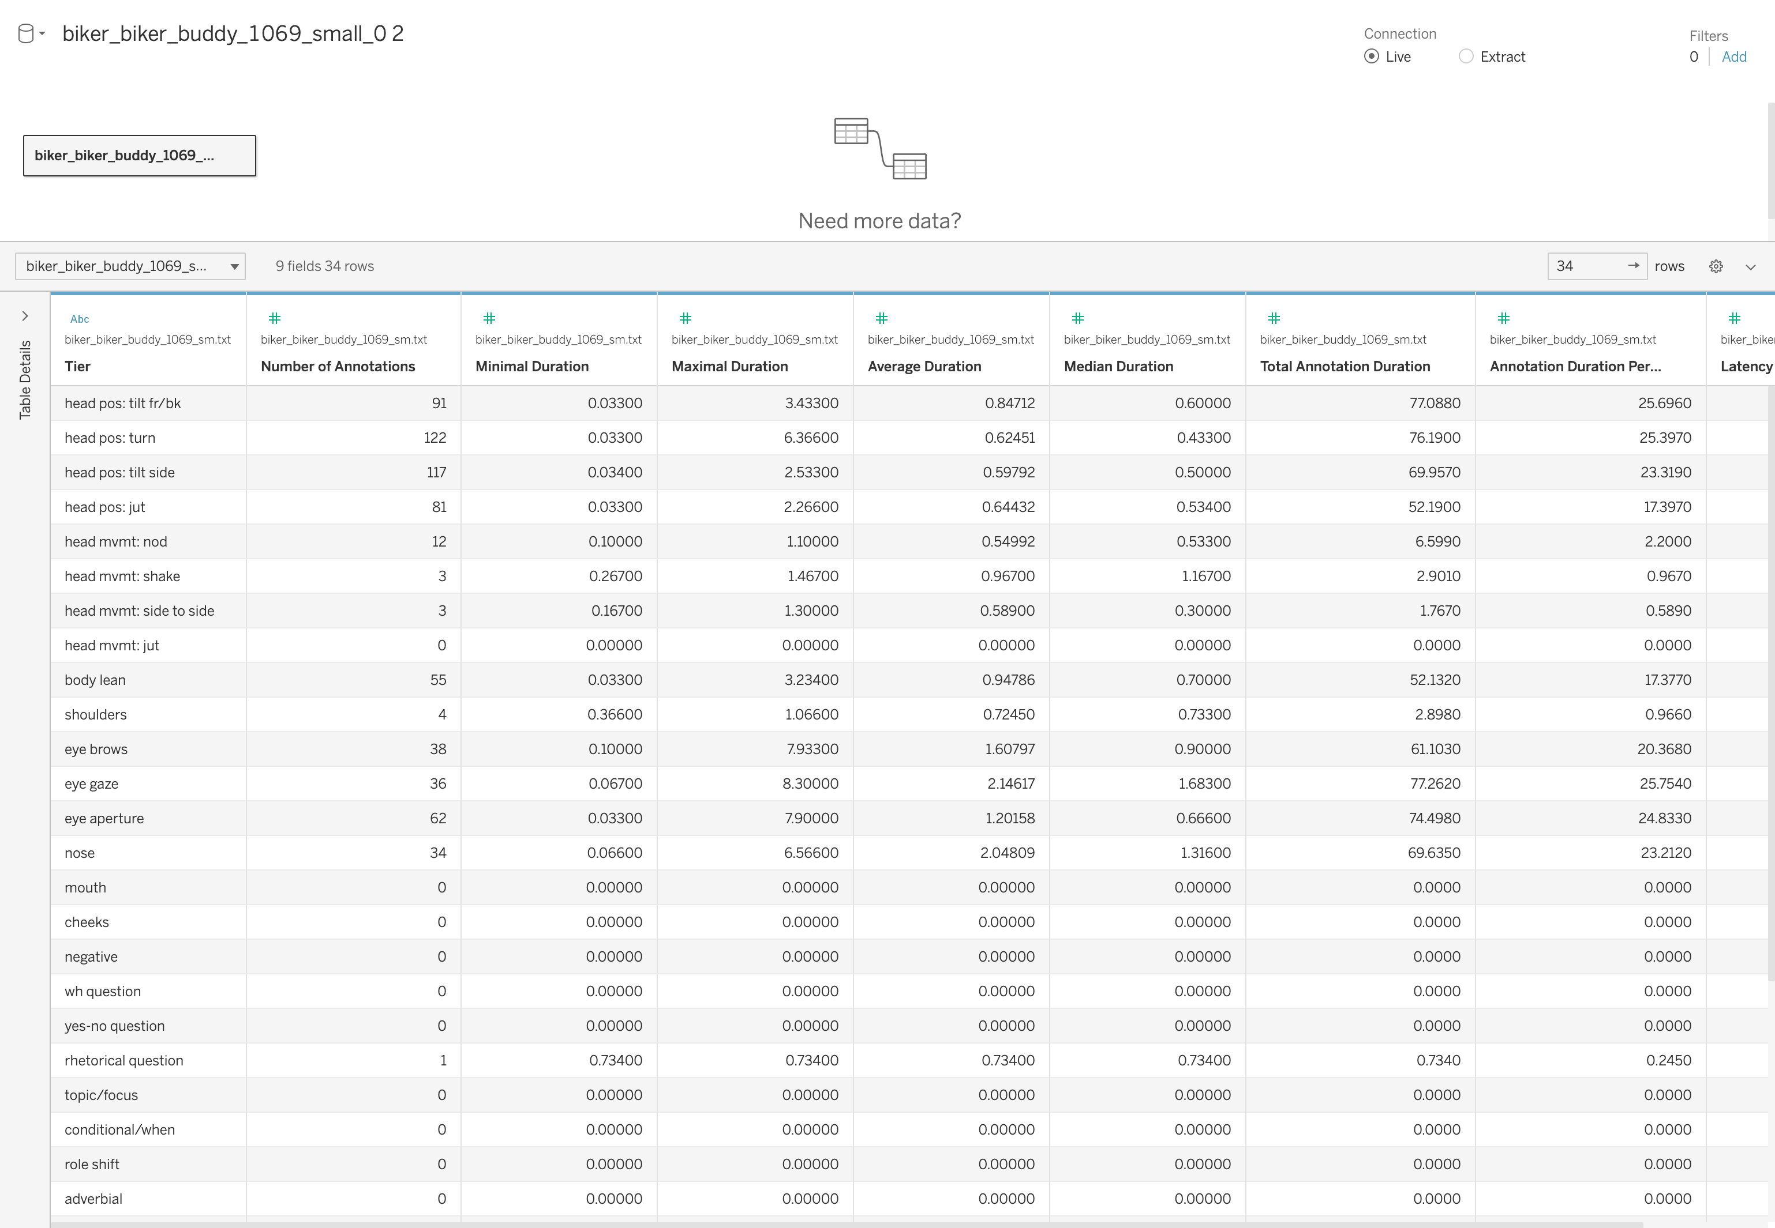
Transfer text file to tableau to do analysis did a little cleaning

Slide 5
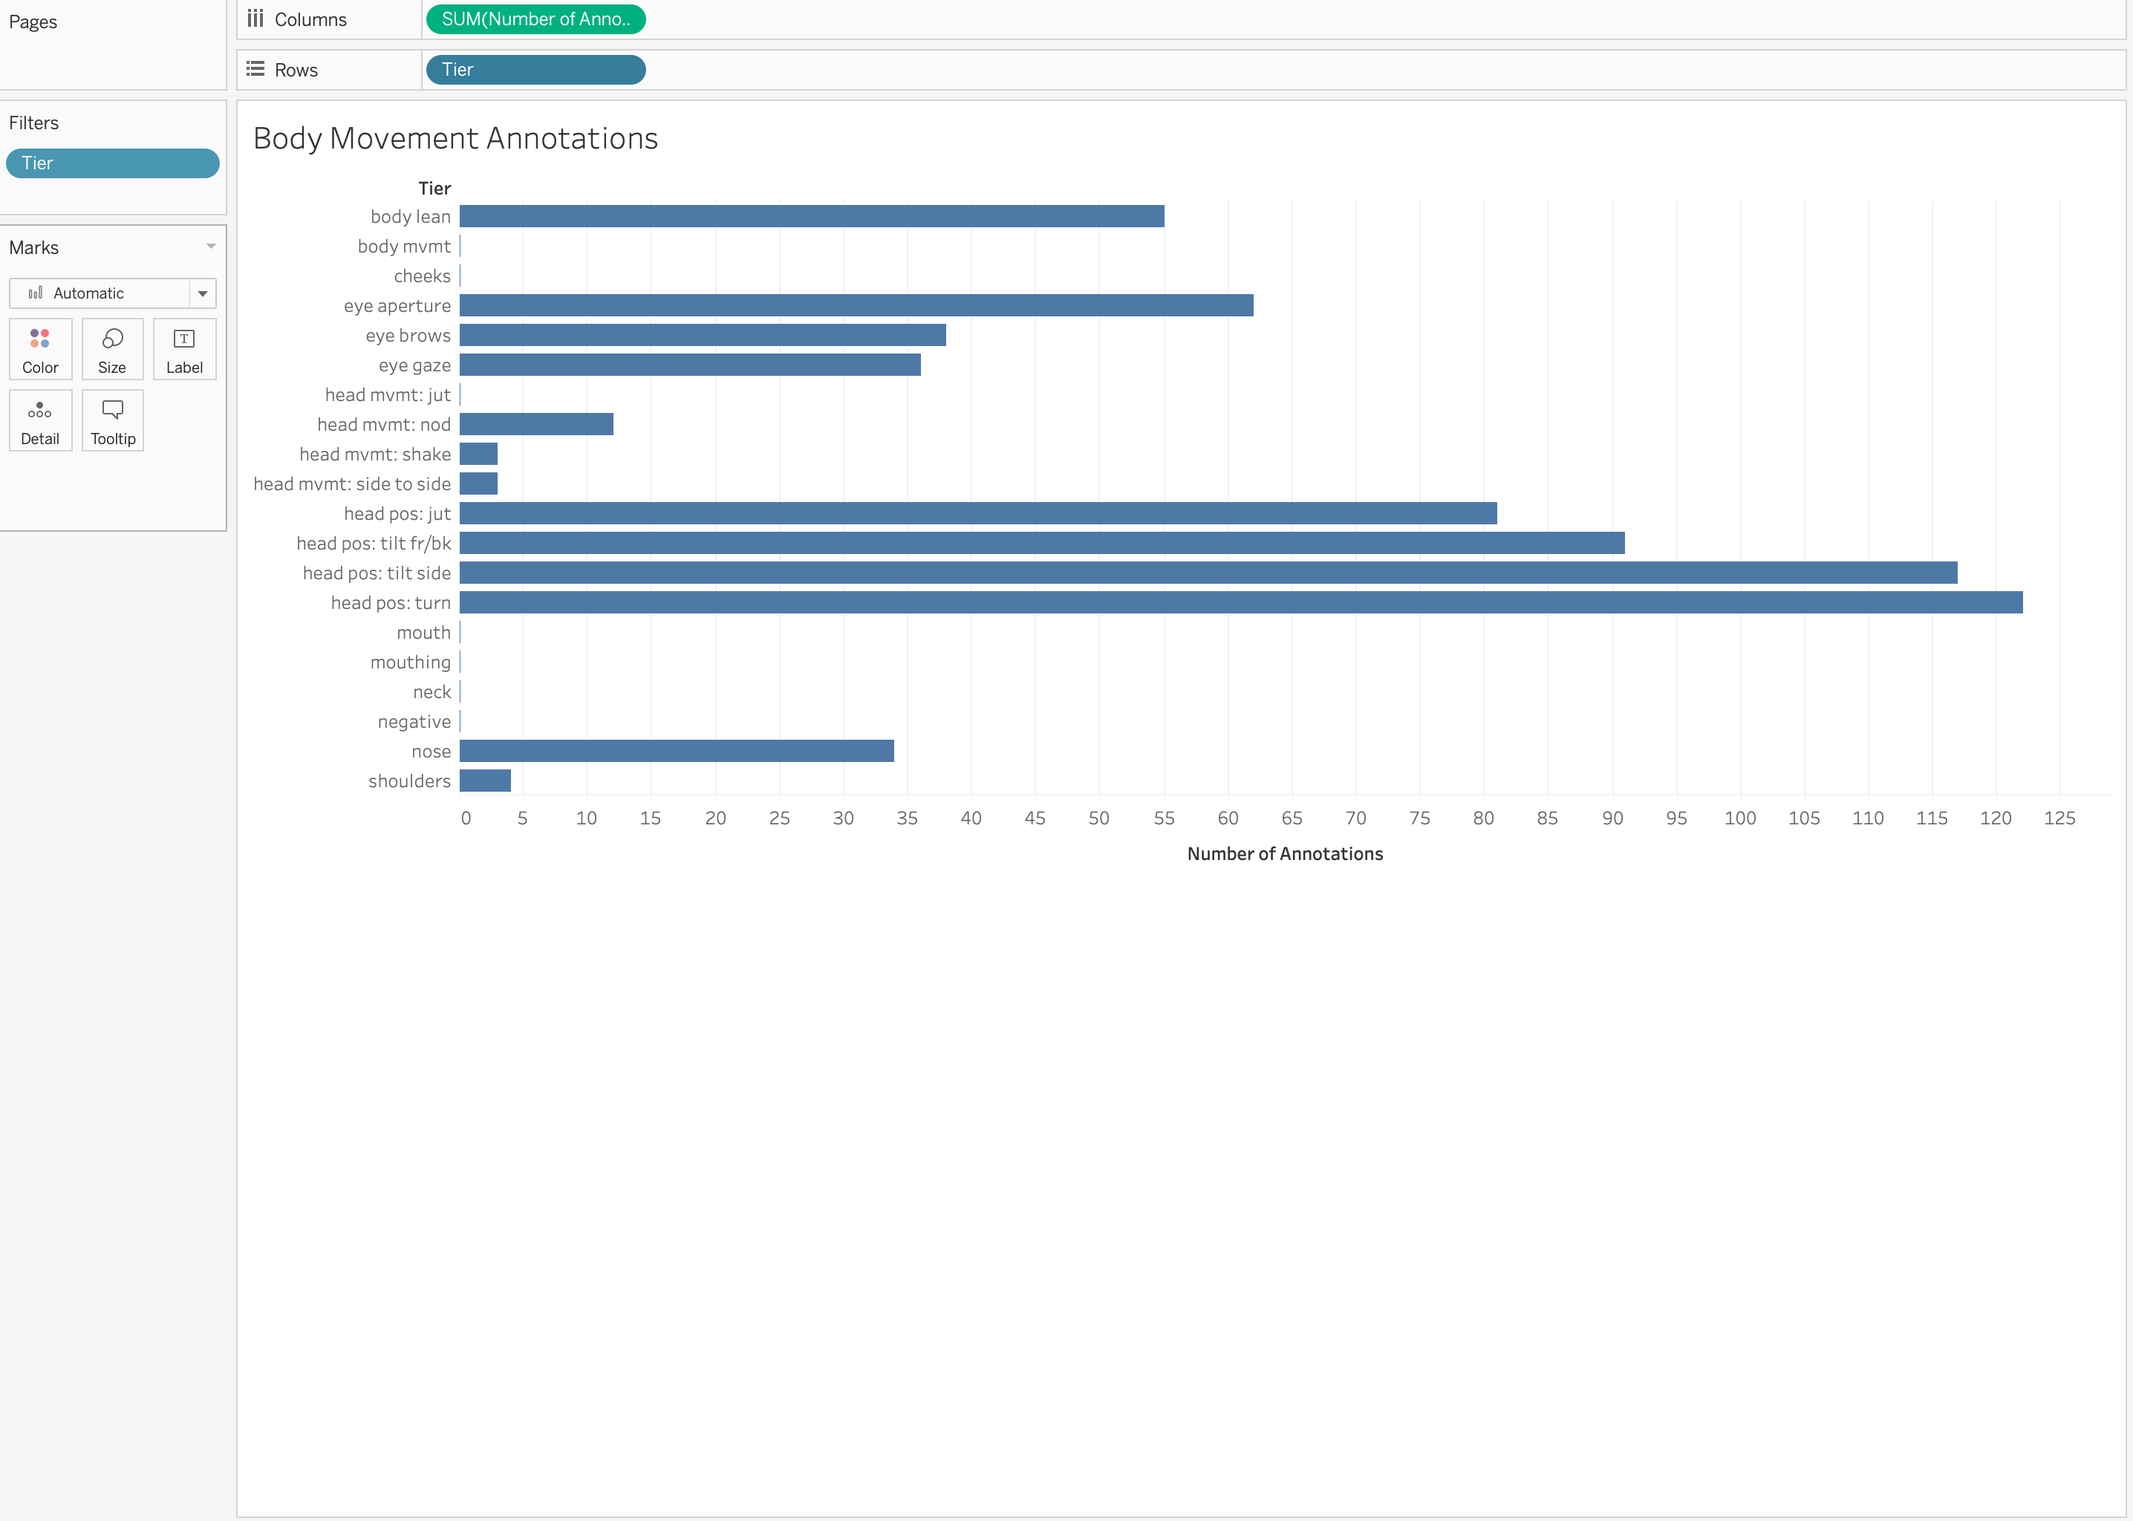
Create visuals visual 1 Body movement analysis bar graph shows the trends for the number of annotations within each tier

Slide 6
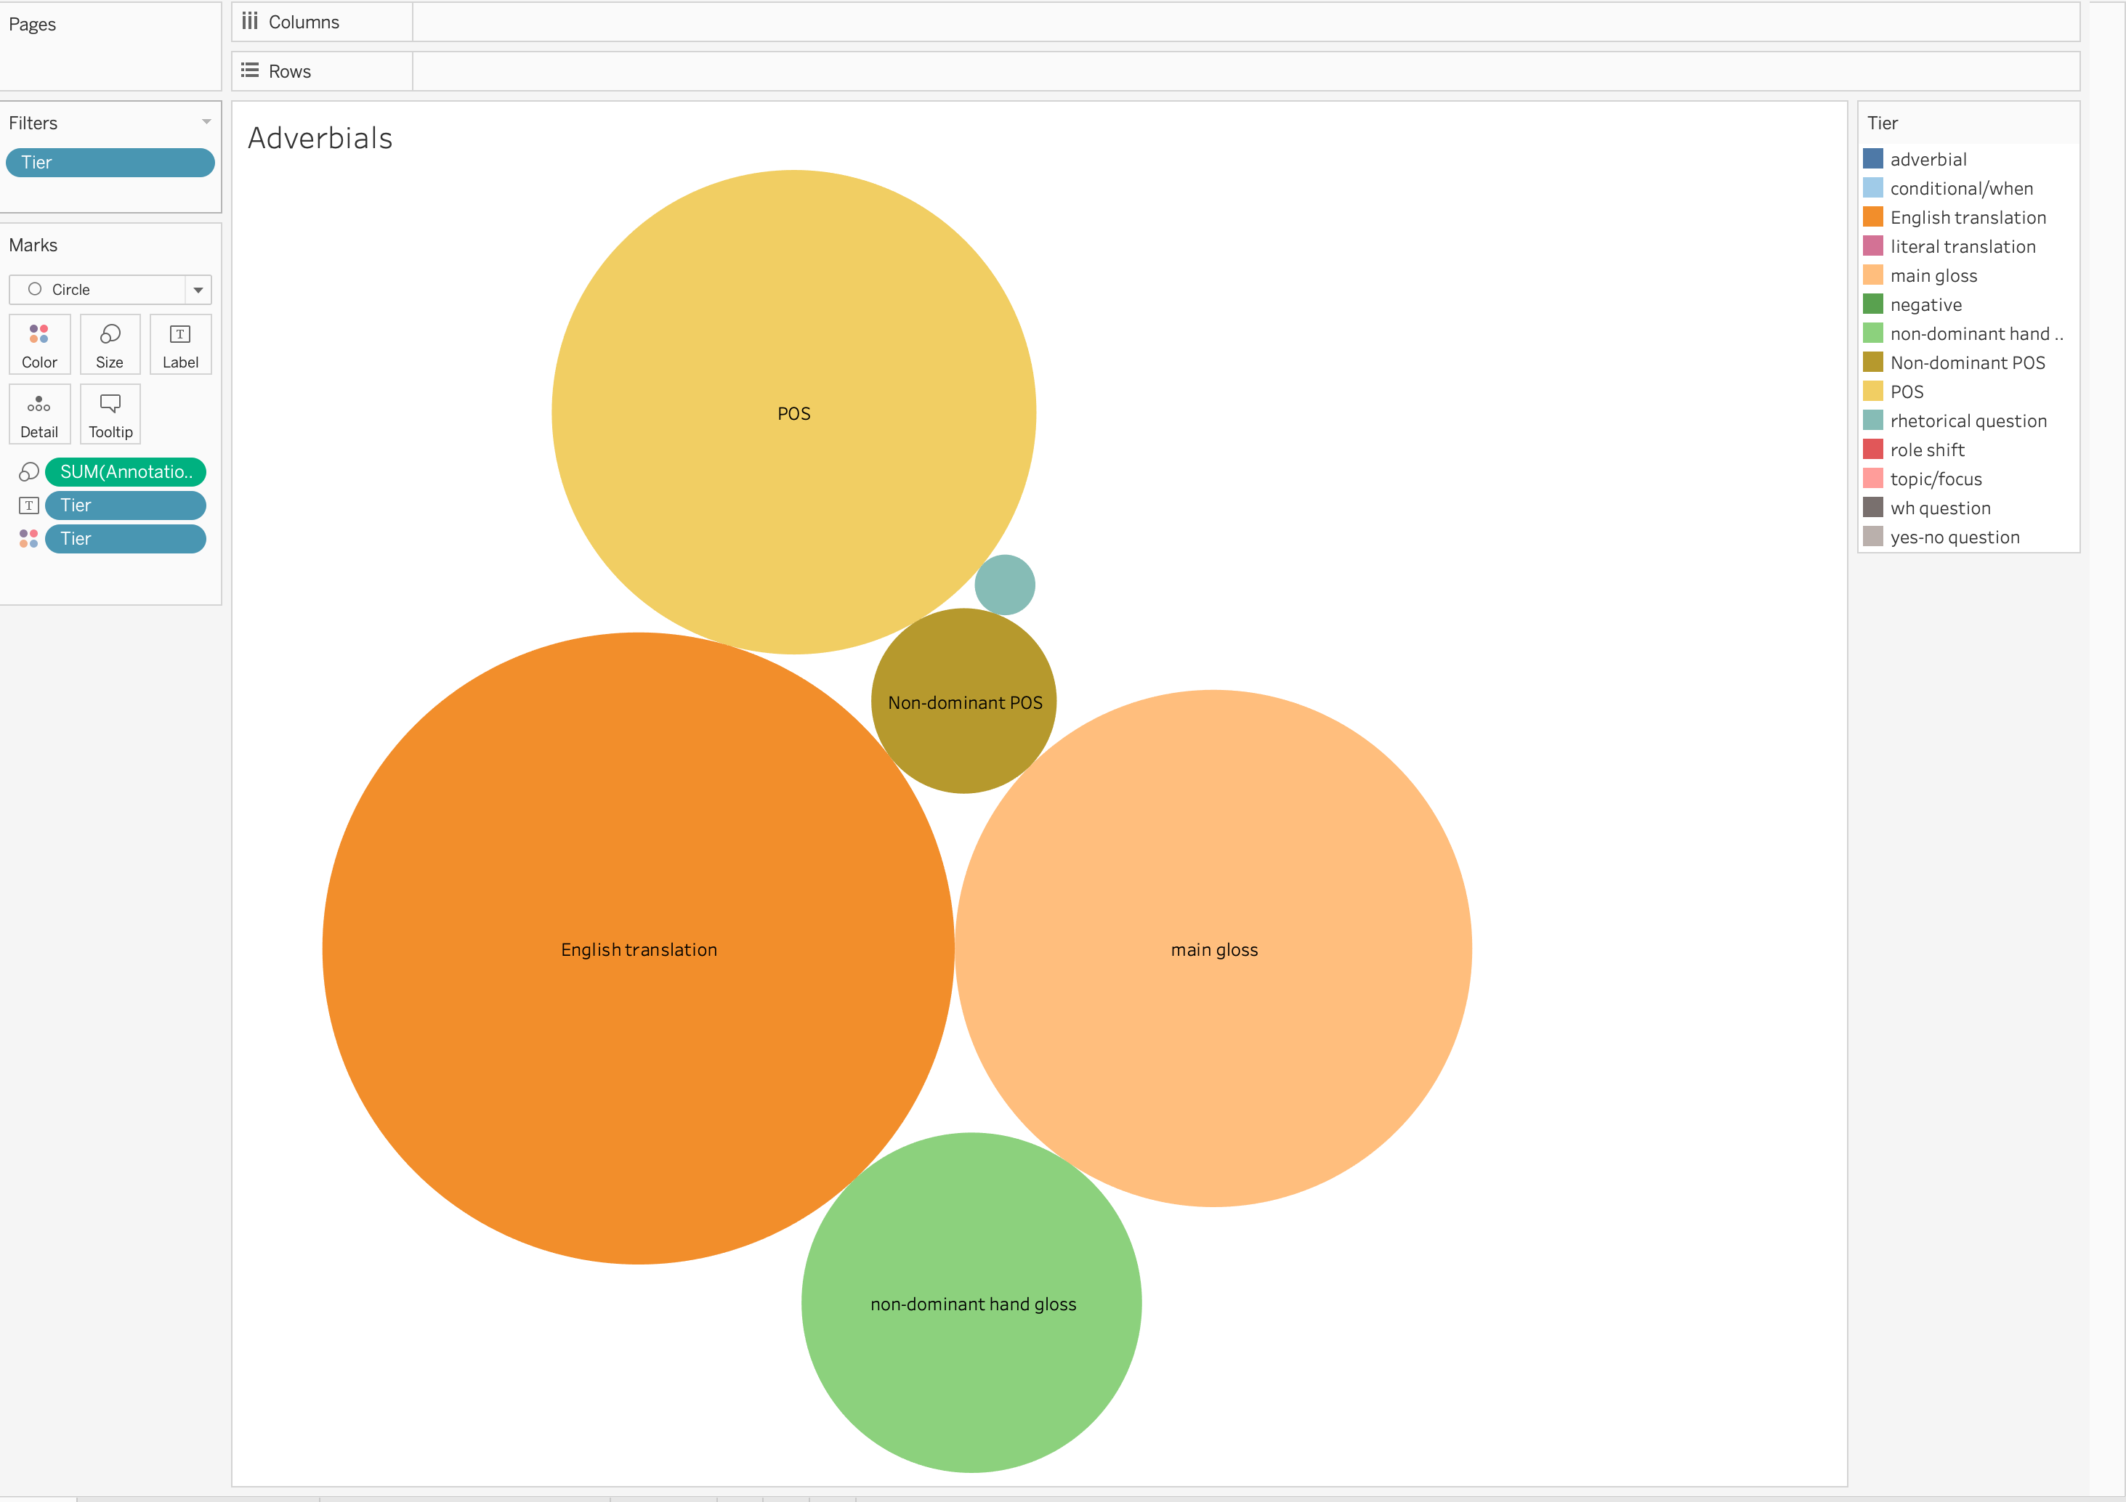
Visual 2- packed bubbles shows the size of each adverbials within each tier

Slide 7
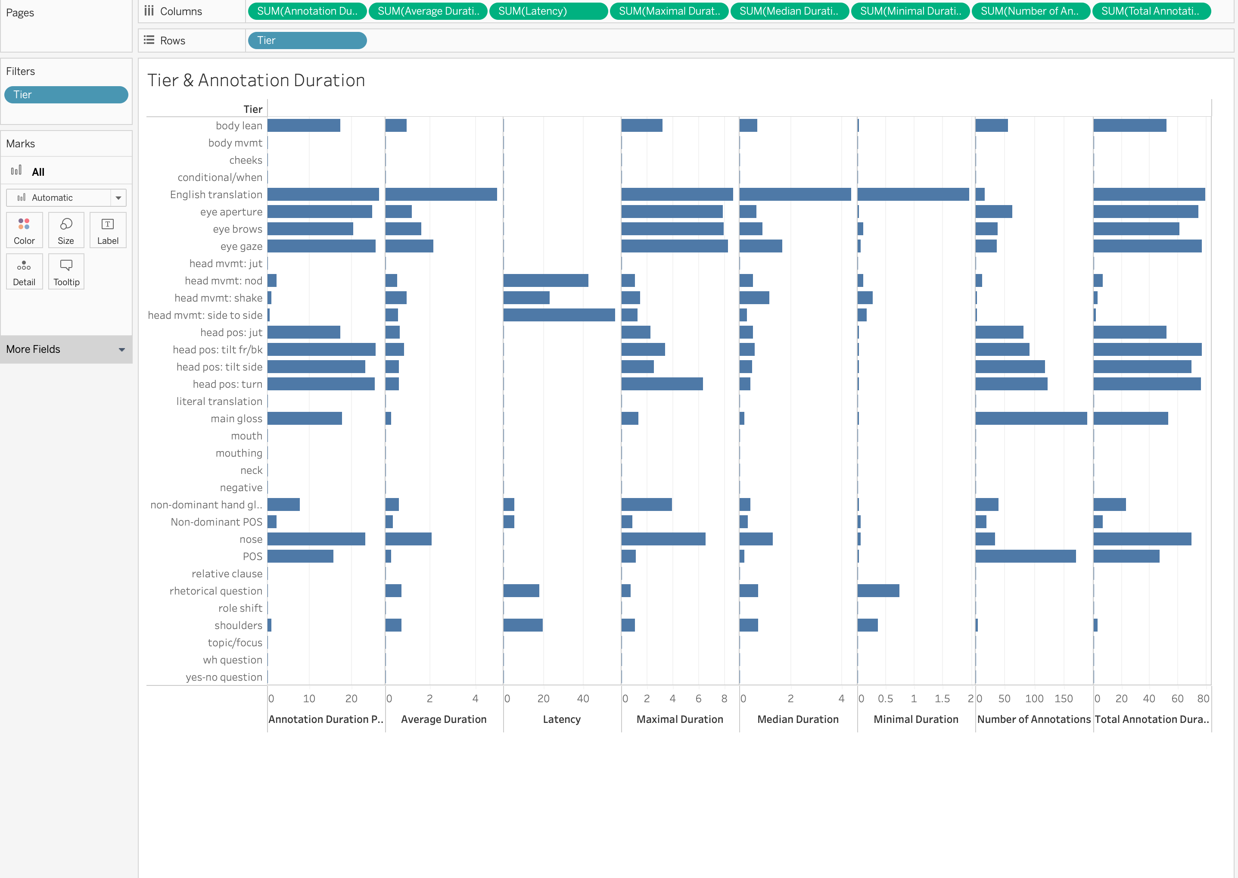
Visual 3- tier & annotation timeline duration side bars shows comparison for each annotations within each tier

Slide 8
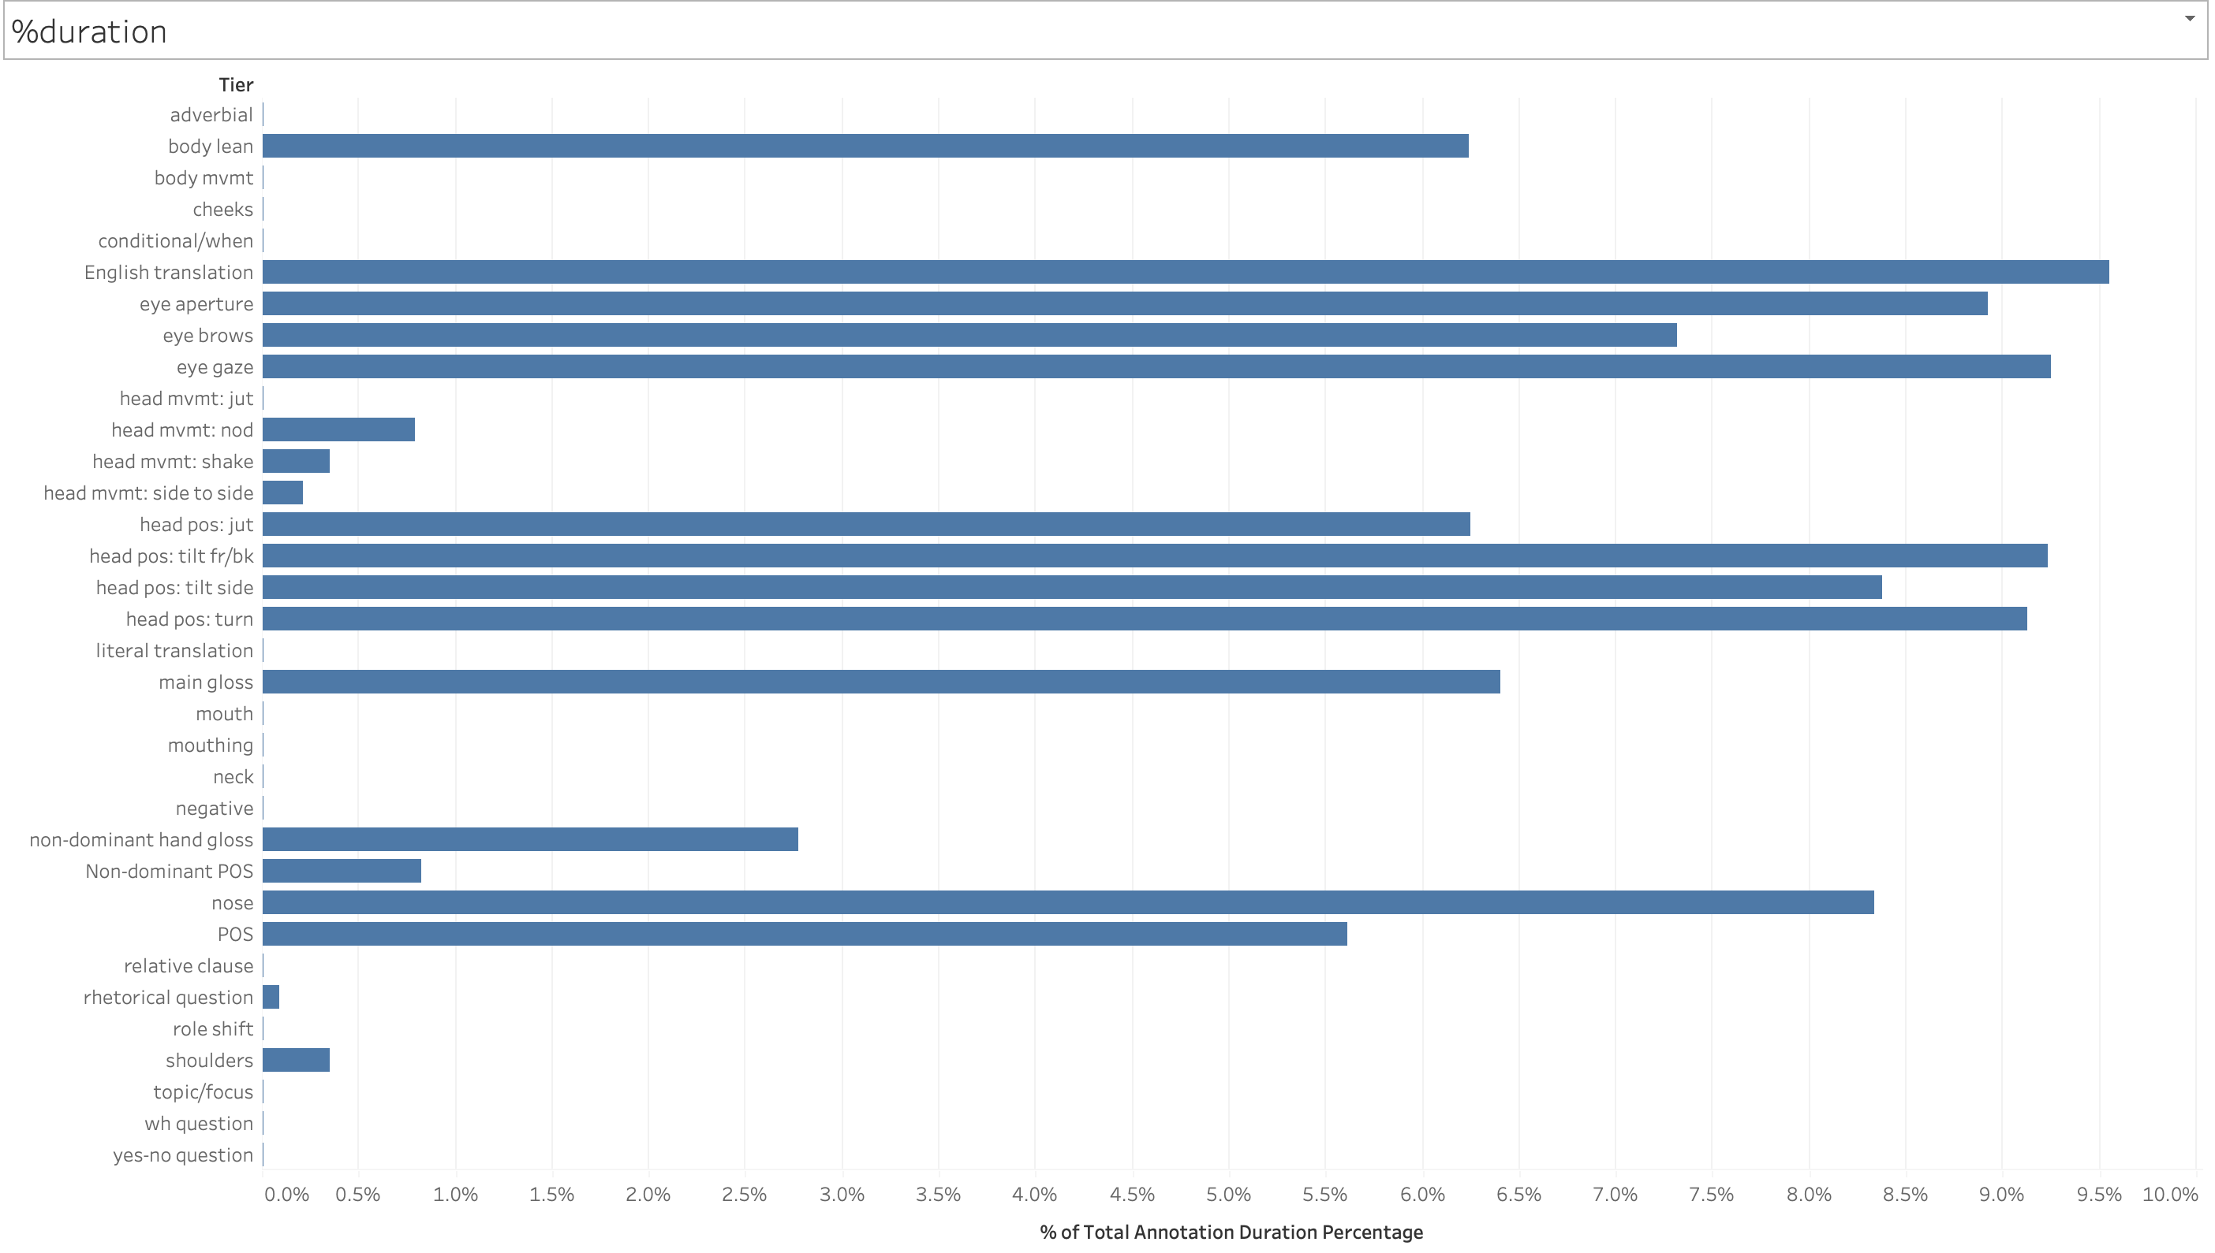
Visual 4
percentages of the duration
associated with tier

Slide 9
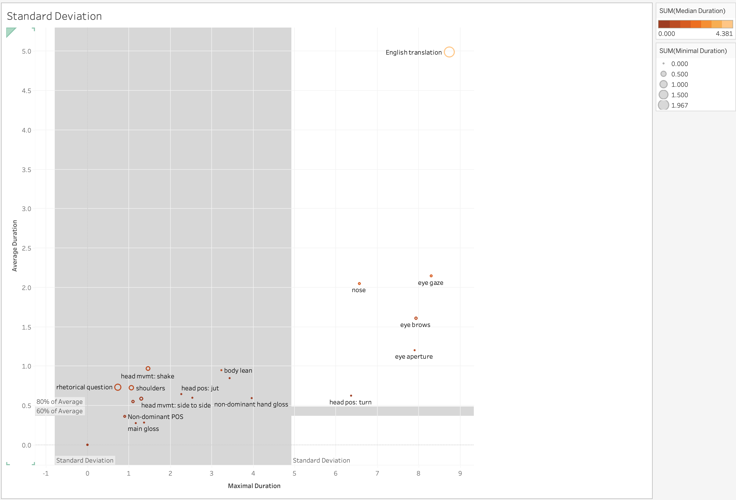
Visual 5
Standard deviation of the spread of data

Slide 10
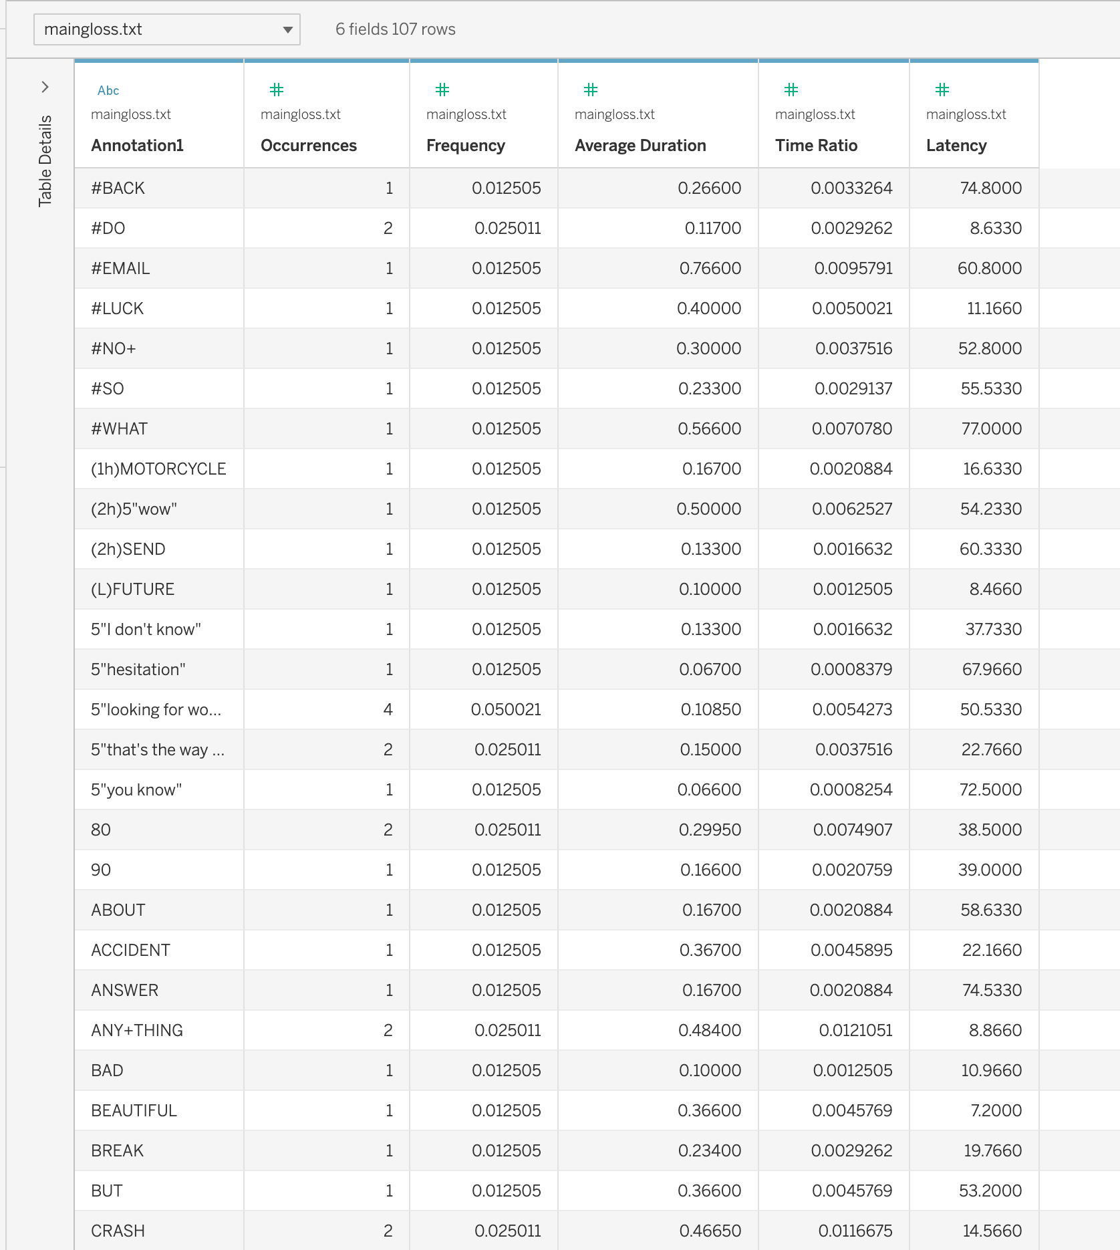
Visual 10
Maingloss Data

Slide 11
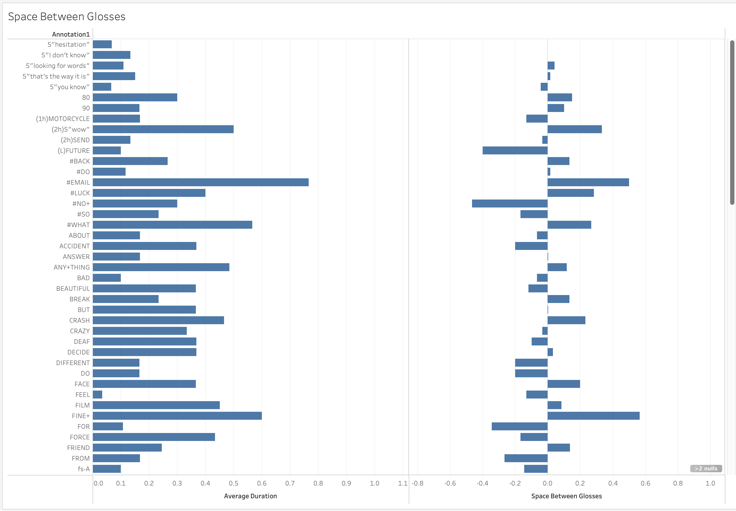
Visual 11
Space between glosses and duration

Slide 12
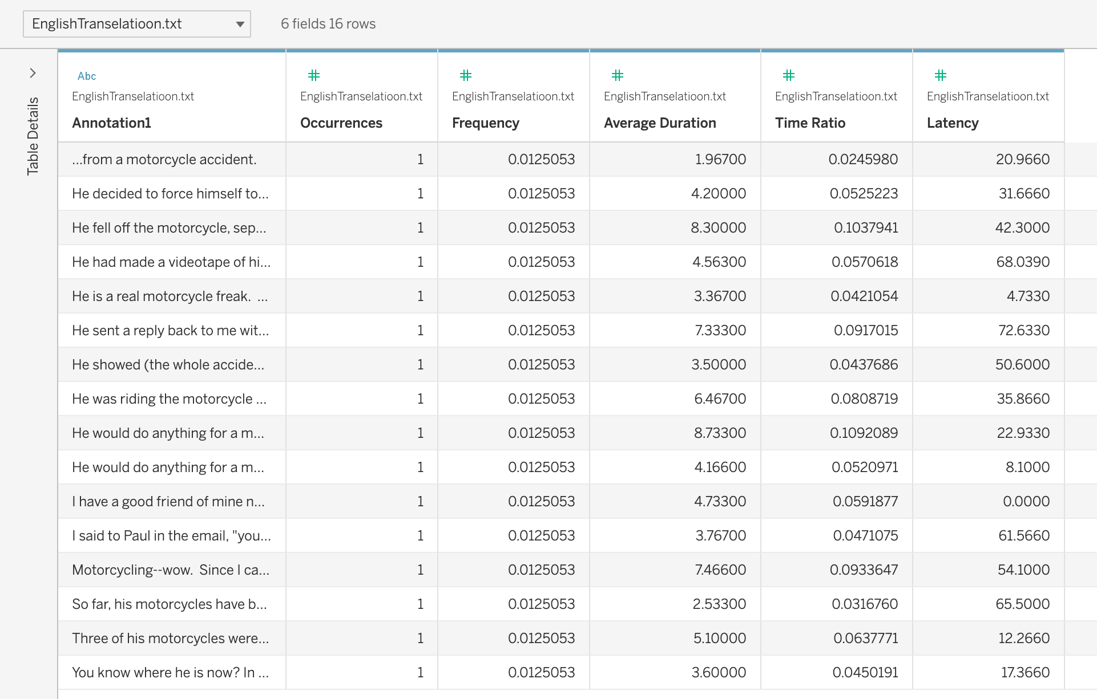
Visual 12
English Transelation Data

Slide 13
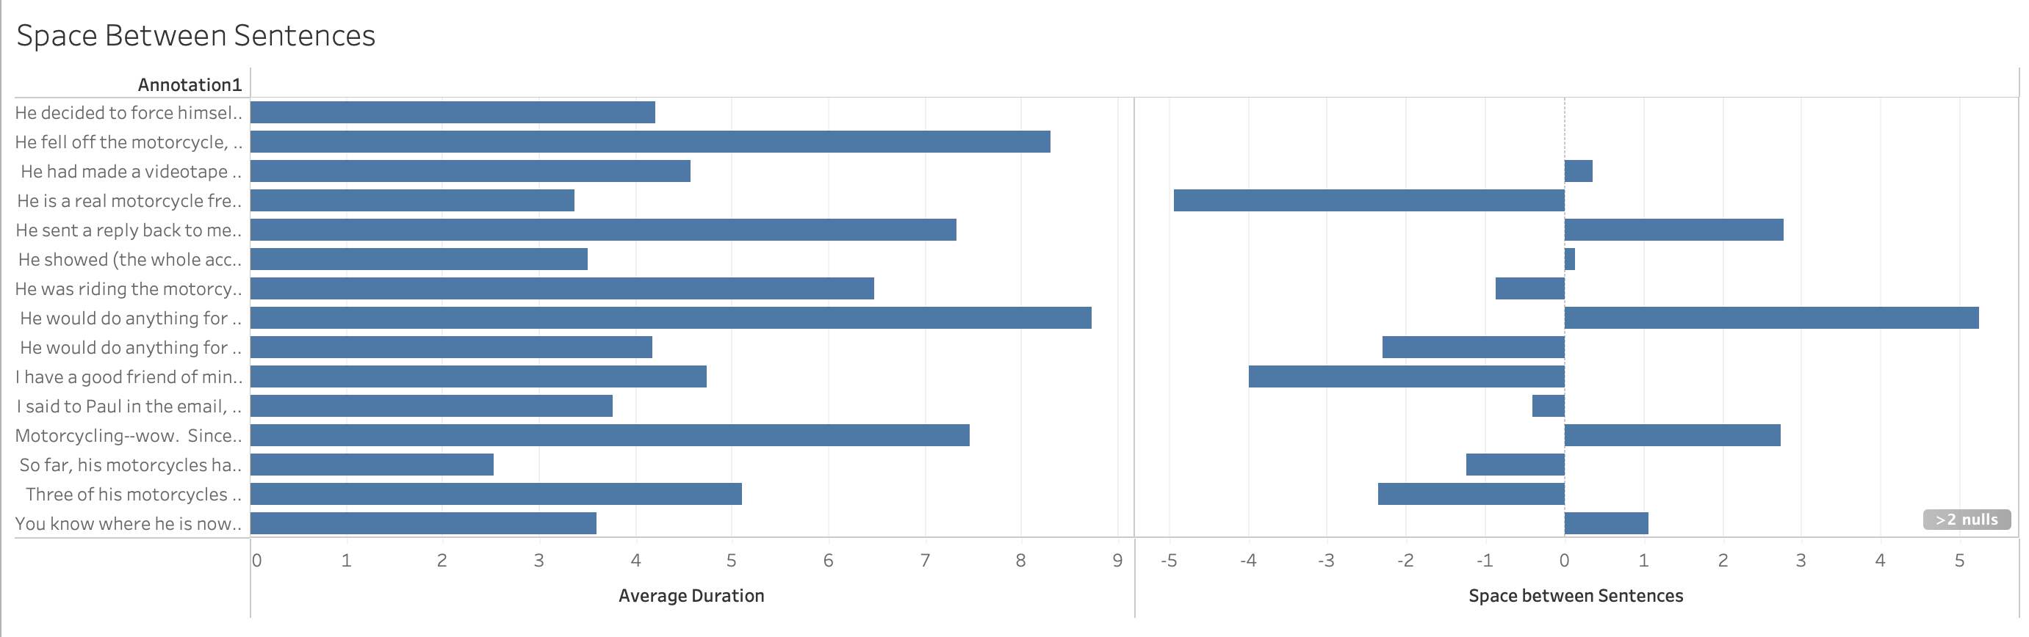
Visual 13
Space between sentences and duration

